Slide 2
1 “Children, obey your parents in the Lord, for this is right. 2 Honor your father and mother, which is the first commandment with promise: 3 that it may be well with you and you may live long on the earth. 4 And you, fathers, do not provoke your children to wrath, but bring them up in the training and admonition of the Lord.”

Slide 4
To Succeed, Parents must “train”
“Through wisdom a house is built, and by understanding it is established; by knowledge the rooms are filled with all precious and pleasant riches” (Proverbs 24:3-4).
3 John 4
Ephesians 5
“Behold, children are a heritage from the LORD, the fruit of the womb is a reward. Like arrows in the hand of a warrior, so are the children of one's youth” (Psalm 127:3-4).
Luke 2:52

Slide 5
What is the goal of your parenting?
What do you wish to accomplish as a parent?
What do you want your child to be 5-years from now?
What kind of adult do you expect your child to become?

Slide 7
chanak
(literally: “To put into the mouth”).
Means: “to instruct so as to make proficient or qualified.”
Genesis 14:14, “Now when Abram heard that his brother was taken captive, he armed his three hundred and eighteen trained servants who were born in his own house, and went in pursuit as far as Dan.”
catechize

Slide 8
Training children is not just . . .
Telling Them
Teaching Them
Showing Them
Raising Them

Slide 9
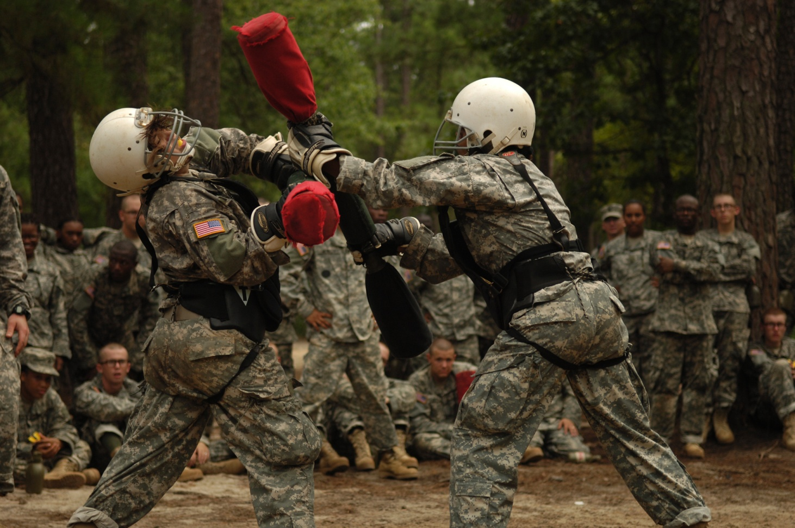
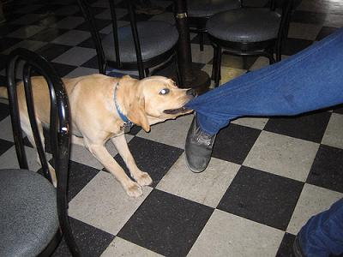
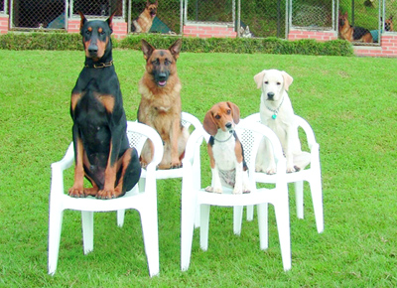
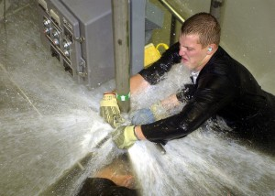

Slide 10
. . . to give his/her heart to the Lord,
. . . to respect your authority,
. . . to exercise self-control,
. . . to be kind and considerate,
. . . to confess wrongs / sins,
. . . to be helpful around the house,
. . . to become servants of others,
. . . to accept there is no profit in disobedience.

Slide 11
“The rod and rebuke give wisdom, but a child left to himself brings shame to his mother” (Proverbs 29:15).
“A wise son makes a glad father, but a foolish son is the grief of his mother” (Proverbs 10:1).

