Slide 1
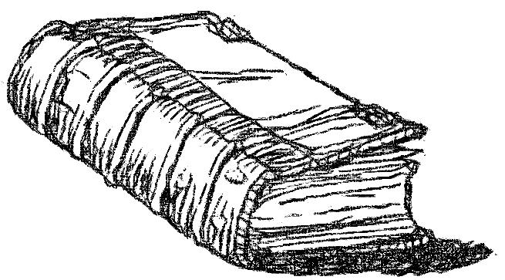
"You are My witnesses," says the LORD, "And My servant whom I have chosen, That you may know and believe Me, And understand that I am He. Before Me there was no God formed, Nor shall there be after Me.
Isaiah 43:10
Notes:
Compare Isaiah 44:8. Not only is there a God, but there is only one true God. God was not formed or created but has existed before all things and will likewise continue to exist after all things. He is the first and the last, the alpha and omega (Rev. 1:11). He is before all things. Col 1:17, “And He is before all things, and in Him all things consist.”

Slide 2
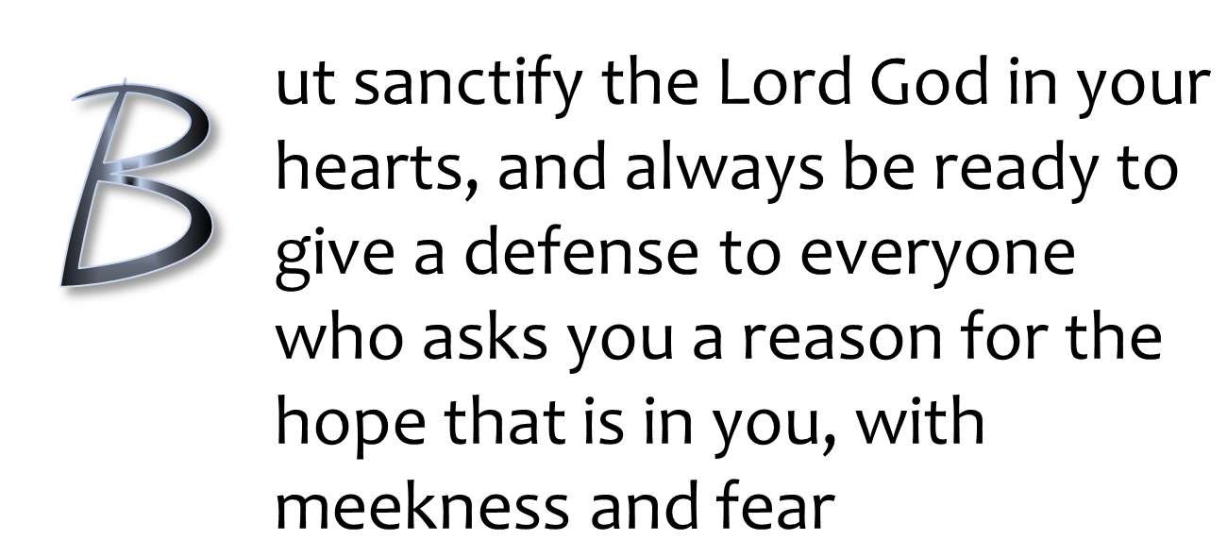
1 Peter 3:15

Slide 3

FAITH?
Is There Really A God In Heaven?
All verses are from the NKJV unless noted.

Slide 4
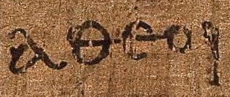

What Is An Atheist?
“that at that time you were without Christ, being aliens from the commonwealth of Israel and strangers from the covenants of promise, having no hope and without God in the world”
(Eph. 2:12)
“atheists”
The Greek word αθεοι (atheoi), as it appears on Papyrus ⁴⁶ in Paul’s epistle to the Ephesians 2:12
(c. 175-225 AD)

Slide 5
What Is An Atheist?
Originally understood as those who lived without God, the godless
Not knowing or worshipping God
Deny the existence of Deity
Incorrectly used today by some as “lack of belief in God”
“atheists”
The Greek word αθεοι (atheoi), as it appears on Papyrus ⁴⁶ in Paul’s epistle to the Ephesians 2:12
(c. 175-225 AD)

Slide 6

What Is An Atheist?
Incorrectly as “lack of belief in God”
  Is this a group of atheists?
“atheists”
The Greek word αθεοι (atheoi), as it appears on Papyrus 46 in Paul’s epistle to the Ephesians 2:12 (c. 175-225 AD)

Slide 7
Misunderstanding Faith
FALSELY ASSERTED: “Anything can be proven by ‘faith’ so ‘faith’ is futile in proving anything.”
  The “proof” of a good business venture is not simply because it is believed to be good
  The “proof” that there is a God is not simply because it is believed there is a God

Slide 8
Nature of Faith
“Now faith is the substance of things hoped for, the evidence of things not seen” (Heb. 11:1)
FAITH
substance/evidence
THE UNSEEN
“let us draw near with a true heart in full assurance of faith…” (Heb. 10:22)
most certain confidence
Notes:
Because something is unseen does not make it unreal.

Slide 9

Evidence & Faith
    “but if I do, though you do not believe Me, believe the works, that you may know and believe that the Father is in Me, and I in Him” (Jn. 10:38)
Works
Evidence
Know & Believe
Knowledge of Evidence
Father In Christ
The Faith From The Evidence

Slide 10
Evidence & Faith
How can a person believe and love someone he has not seen?
  “whom having not seen you love. Though now you do not see Him, yet believing, you rejoice with joy inexpressible and full of glory” (1 Pet. 1:8)
unseen
believed
loved

Slide 11
Evidence & Faith
unseen
believed
loved
Evidence Had To Be Presented
PREACHING
(1 Pet. 1:25; Rom. 10:17)
CREDIBLE TESTIMONY
(2 Pet. 1:16-21)

Slide 12

Scientism
“Belief in the unseen is weird…why should I believe in God? People who pray to something “unseen” are loony.
I won’t believe anything unless I can see it.”
Yet many of them believe in evolution without seeing it!

Slide 13
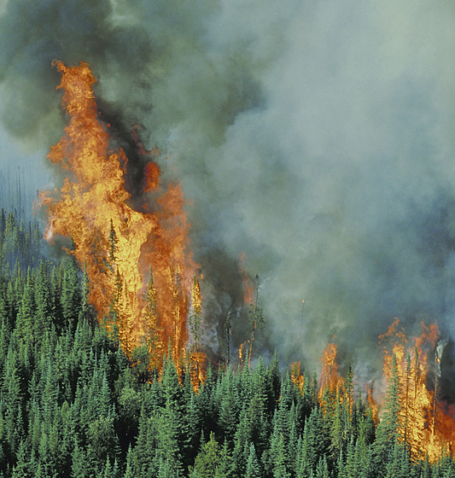
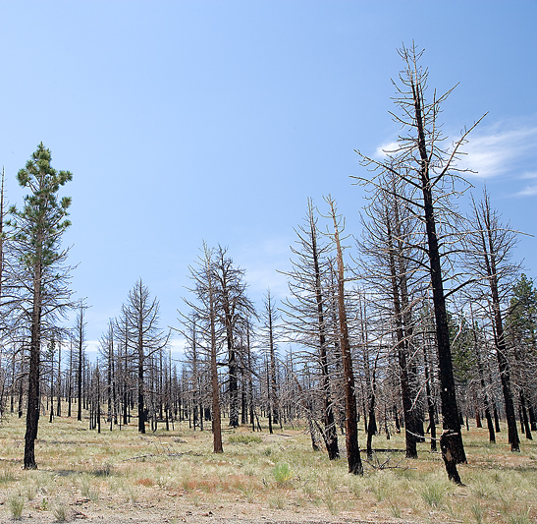
Seeing the Unseen
I Don’t Have To See The FLAMES
To Know They Were In This FOREST

Slide 14
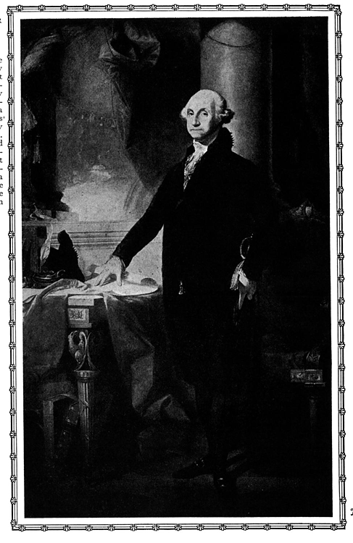
Do You Believe In George Washington?
Do you believe he was our first president?
Do you believe he even existed?
  Have you seen him?
  Have you heard him?
  Have you talked with him?
Notes:
If we live life being governed by a strict scientism, then we will be forced to reject all historical statements.

Slide 15
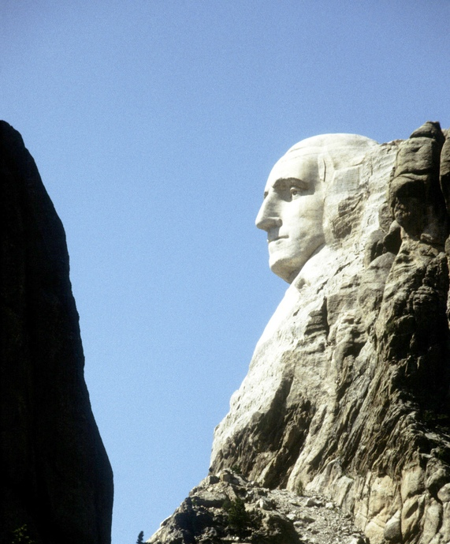
Do You Believe in Mount Rushmore?
Do you believe it is real or a fabrication?
If you believe it real…
  Do you believe it was given to us by aliens?
  Do you believe it was the product of erosion?
  Do you believe it was the product of random and violent explosions?
  Do you believe it was designed by intelligence?
Notes:
How many of you believe Mount Rushmore is real? How many of you have seen it? How many of you saw it with your own eyes? More people believe it is real than the number of people who actually saw it? For those of you who haven’t seen it, how do you know the whole Mount Rushmore thing is not just a fabrication? For those of you who have seen it, how did we get it?

Slide 16
Is
There
A God
!
?
“But there is a God in heaven who reveals secrets, and He has made known to King Nebuchadnezzar what will be in the latter days….” (Dan. 2:28).
Notes:
Aug., 2010 - Sunnyside
“Is there a God?” Such is the question that has been asked by countless numbers throughout time. This question has been met with a resounding answer by a myriad of voices in switching the “is” and “there.” [click]
So we gladly join the ancient echo asserting “There is a God!” This answer was given by various men in various circumstances who provided various. King David stood before a giant of a man and an imposing army of infidels and said, “…And this day I will give the carcasses of the camp of the Philistines to the birds of the air and the wild beasts of the earth, that all the earth may know that there is a God in Israel” (1 Sam. 17:46).
[click] Hundreds of years later, Daniel made this assertion to one of the most powerful rulers the world has ever known. He exclaimed to the perplexed Nebuchadnezzar, “But there is a God in heaven who reveals secrets, and He has made known to King Nebuchadnezzar what will be in the latter days….” (Dan. 2:28).

Slide 17
The Bible’s Argument For God!
From Prophecy (Dan. 2:28)
“(as it is written, ‘I have made you a father of many nations’) in the presence of Him whom he believed—God, who gives life to the dead and calls those things which do not exist as though they did”
(Rom. 4:17)
1
prophecy
2

Slide 18
Daniel (2:28)
Affirmed “There is a God’ because of the power to reveal dreams
Dream was revealed and interpreted
The dream’s revelation spoke of the rise and fall of four world empires and also establishing the kingdom of heaven (Dan. 2:44)
  The prophetic revelation has proven true in every detail

Slide 19
The Kingdoms In Daniel
Described as beasts
Babylon (lion)
Mede/Persian (bear)
Greece (leopard)
Rome (dreadful & terrible)
Son of Man’s kingdom
Daniel 7:1-3, 17
7:4
7:5 (cf. ram, 8:20)
7:6 (cf. male goat, 8:21, 22)
7:7, 23
7:13, 14

Slide 20
How Could Daniel know and describe four world empires?
How could Daniel foresee the coming kingdom of Christ?
ANSWER: “But there is a God in heaven who reveals secrets, and He has made known to King Nebuchadnezzar what will be in the latter days….” (Dan. 2:28).

Slide 21
Crucifixion of Messiah
“For dogs have surrounded Me; The congregation of the wicked has enclosed Me. They pierced My hands and My feet” (Ps. 22:16)
  1000 years before Christ
  Hundreds of years before the act of crucifixion
  Dead Sea Scroll (4QPs^{f}) predates Christ’s crucifixion and verifies the boring through the hands and feet
Many other like prophecies could be studied!
Notes:
4QPs^{f} 4 (cave 4); Q (Qumran; [koom-rän’]); Ps (Psalms) f (sixth scroll). This scroll may also be referred to as “4Q88” (the 88th manuscript from cave 4).

Slide 22
The Bible’s Argument For God!
From Prophecy (Dan. 2:28)
From The heavens (Ps. 19:1)
“The heavens declare the glory of God; And the firmament shows His handiwork” (Ps. 19:1)
Notes:
Science recognizes that our solar system is governed by laws which ought to make us think that there is one who gave laws and upholds them. How could law come from chaos?

Slide 23
Life, Law & Order
The Universe
  The constancies of nature
    Rotation of earth about 1000 miles an hour at equator: same speed every day!
    Orbit of the sun: 18.59 miles/second
    Gravitational pull/centrifugal force perfectly balanced
    Size of the earth
  Laws in nature point to a Law-giver
Notes:
There is a preciseness of the solar system by which we can set our watches by. Our calendars are based on the earth’s orbit around the sun. How did this constancy come from chaos?
Regarding orbit around the sun: Approximately 67,000 miles an hour. If the world stopped spinning the atmosphere would continue to spin and scour everything on the surface of the earth. If the earth slowed down, the balance between day and night would adversely affect vegetation growth.

Slide 24
Life, Law & Order
Nothing Ordinary About It!
The Earth: perfect for sustaining complex life!
  Perfect size
  Perfect speed
  Perfect atmosphere
  Perfect distance
What is the chance of such to come into existence by natural processes?
“The heavens declare the glory of God; and the firmament shows His handiwork” (Ps. 19:1).
Notes:
Perfect size: If the earth were twice the size it is now, gravity would make everything on earth weight 8 times what it currently weighs! I would weigh over 1800 lbs! If the earth were significantly smaller, the atmosphere would be too thin to provide protection against the thousands of meteors which contact the earth’s atmosphere every day.
What is the probability of a universe that has no defined purpose, which was conceived and guided by chance, chaos and randomness, to created an environment that is suitable for life—life that is fixated with discovering purpose? What is the chance of that? Keep in mind, that no other place in the universe has been discovered which is hospitable for life.

Slide 25
Some Parameters Scientists Say Are needed for Complex Life to Exist
proper gravitational force
placement in the small habitable region of a galaxy
an oxygen rich atmosphere
large land mass and abundant liquid water
a home star of correct mass and temperature
an orbiting route that is not too close or too far away from the star
a large moon
a magnetic field that is strong enough to deflect radiation

Slide 26

What is the Chance?
What is the chance of all these conditions occurring out of non-intelligent matter, chance, and chaos?
  $\frac{1}{1, 000,000,000,000,000}$
You would have a better chance of having the book of Genesis written by 1 million monkeys randomly typing keys!
Notes:
1 in 1 quadrillion or 1 in 1000 trillions.

Slide 27

The Bible’s Argument For God!
From Prophecy (Dan. 2:28)
From Creation – the heavens (Ps. 19:1)
From the things made – on earth (Rom. 1:20)
“For since the creation of the world His invisible attributes are clearly seen, being understood by the things that are made, even His eternal power and Godhead, so that they are without excuse” (Rom. 1:20)
Creation → things that are made→ invisible attributes seen

Slide 28
Life Is Something Made
Anything that “begins” to exist has a cause
Physical life began to exist
Physical life has a cause
  What was that cause?
    Random natural processes spawned life over long ages of time?
    Physical life was caused by ETERNAL LIFE
“I will praise You, for I am fearfully and wonderfully made; Marvelous are Your works, And that my soul knows very well” (Ps. 139:14)

Slide 29
Explanation of Life
The Atheist: life began from non-living material through purely natural processes
  Presupposition: In the beginning was only matter and energy
  “The Cosmos is all that is or ever was or ever will be” (Carl Sagan, Cosmos, New York: Random House,1980, p. 4.)
  From a purely material source →life
Atheism opposes observational science
  Law of Biogenesis
  Existence of the non-material (neither mass nor energy)
Notes:
Consciousness, will, information, memory, etc.

Slide 30

Information
“Namely an encoded, symbolically represented message conveying expected action and intended purpose” (Dr. Werner Gitt, http://creation.com/laws-of-information-1#txtRef7)
What causes information to come into existence?
Can information rise spontaneously from non-information or must it come from the conscience and will of a sender?

Slide 31
Information
Does information exist?
Is information a property of matter or energy?
  Information is written in matter, but is a nonmaterial entity
Can information arise from matter without an intelligent sender?
Yes
No
Yes
No
Yes
No
Blank CD weighs the same even after information is placed or erased
Notes:
Imagine writing a message in the sand. This conveys that information is written in matter, but is not itself matter. Information is therefore “massless.”
Writing on a chalk board can relate information. The chalk is not information. If I take my hand and wipe the chalk, all I have is chalk dust on my hand, but I have no information.

Slide 32
The Levels Of Information
Purpose
Syntax
Semantics
Pragmatics
Code and rules (e.g., grammar and vocabulary)
Fundamentals of Information

Slide 33
The Levels Of Information
Purpose
Syntax
Semantics
Pragmatics
“For if the trumpet makes an uncertain sound, who will prepare himself for battle?”
(1 Cor. 14:8)
A symbol or symbols associated with meaning (“quiet” versus “tqieu”)
Fundamentals of Information

Slide 34
The Levels Of Information
Purpose
Syntax
Semantics
Pragmatics
A desired action from the sender for the receiver to do
Fundamentals of Information Transmission

Slide 35
The Levels Of Information
Purpose
Syntax
Semantics
Pragmatics
The outcome intended by the sender, relates to the desired fulfillment of the information
“The LORD has done what He purposed; He has fulfilled His word which He commanded…” (Lam. 2:17)
Fundamentals of Information Transmission

Slide 36
No Information; No Life!
Purpose
Syntax
Semantics
Pragmatics
“Information is not life…Information is a necessary prerequisite for life” (Werner Gitt, In The Beginning Was Information, 1999. p. 81)
DNA: language of life
  Like a computer program only far more sophisticated and compact
  DNA has all these levels!
Fundamentals of Information Transmission

Slide 37


HOW MANY BOOKS OF INFORMATION WOULD EXIST IN THIS MUCH DNA?
“ . ”
A PINHEAD SIZE DOT OF DNA
Notes:
How many books would you guess? 1, 10, 100?

Slide 38

Dr. Werner Gitt
“Let's look at the amount of information that could be contained in a pinhead volume of DNA. If all this information were written into paperback books, it would make a pile of such books 500 times higher than from here to the moon! The design of such an incredible system of information storage indicates a vastly intelligent Designer.”
www.answersingenesis.org/articles/cm/v20/n1/dazzling-design

Slide 39
No Information; No Life!
Purpose
Syntax
Semantics
Pragmatics
“DNA has two types of digital information — the genes that encode proteins, which are the molecular machines of life, and the gene regulatory networks that specify the behaviour of the genes.”
Fundamentals of Information Transmission
The digital code of DNA, Leroy Hood & David Galas, Nature, 421, 444-448 (23 January 2003)
http://www.nature.com/nature/journal/v421/n6921/abs/nature01410.html
WHERE did DNA get its digital information?

Slide 40
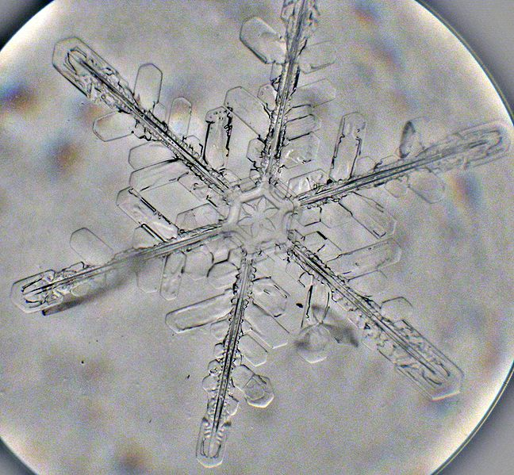
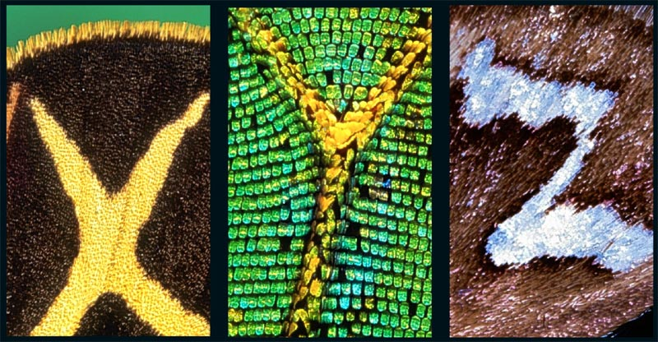
Not Information
The appearance of design on a snowflake
Ornamental letters on the wings of butterflies
No Information Without Code

Slide 41


3 Morse Code Symbols
26 letters
470,000 words
Language
Information
4 nucleotides
20 amino acids
100,000 proteins
Life
Notes:
English speakers can combine symbols and letters to form hundreds of thousands of words which can are used to convey information in the English language. Likewise, the four nucleotides are combined into twenty amino acids to produce all the proteins needed for the diversity of life.

Slide 42
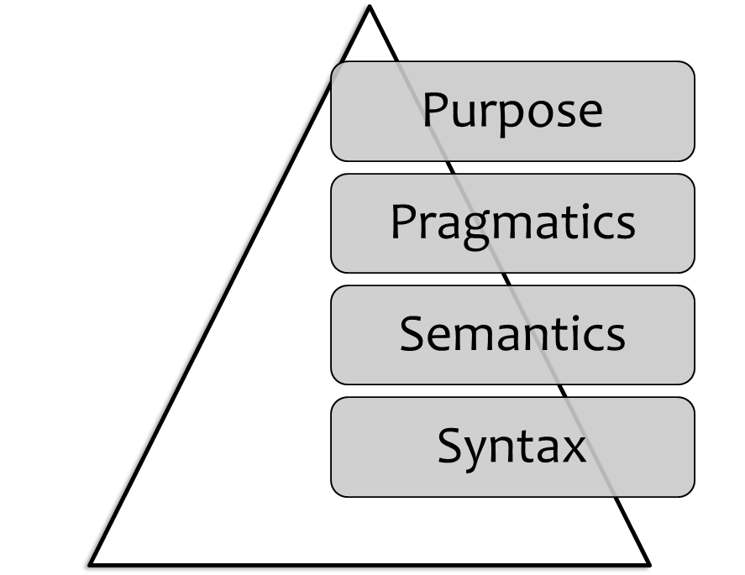
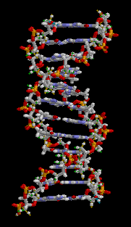
Code | The decoded portion of DNA contains 4 letters (ATCG) that make up three-letter words (codon). These codons are arranged linearly in a various sequence (syntax).
Meaning | Each three-letter word represents 1 of the 20 specific amino acids used in life. The sequence (syntax) of the DNA words designates the specific sequence of the amino acids in protein formation.
Expected Action | Cellular proteins are biomachines essential for construction, function, maintenance, and reproduction of the entire organism
Intended Purpose | Existence of life
Mike Riddle, Information: Evidence for a Creator?: The New Answers Book 2
See, http://www.answersingenesis.org/articles/nab2/information-evidence-for-a-creator

Slide 43
Romans 1
18 For the wrath of God is revealed from heaven against all ungodliness and unrighteousness of men, who suppress the truth in unrighteousness,
19 because what may be known of God is manifest in them, for God has shown it to them.
20 For since the creation of the world His invisible attributes are clearly seen, being understood by the things that are made, even His eternal power and Godhead, so that they are without excuse

Slide 44
Some Laws Of Information In Nature
Cannot be material
  Information is not a property of matter
  Cannot arise out of matter
  A material entity cannot creat a non-material entity
Must be produced by an intelligent sender
  Every information chain can be traced back to an intelligent sender (like a library book, internet page, computer program, radio program, etc.)
Sender more intelligent than the information
  Principle (Heb. 3:3, 4)
    since the information in life’s code exceeds man’s capabilities to originate or reproduce, the original sender must be greater than man

Slide 45
The Sender
5 Conclusions
From Information
1
Must Be Sender
2
Omniscient (DNA density & complexity billions of times greater than man’s achievements)
3
Omnipotent (encoded info. into DNA, construction & design of biomachines, features…)
5
4
Eternal (to be omniscient one must know everything in past and future)
Non-material component (since info. is a nonmaterial entity)
?

Slide 46
The Sender
5 Conclusions
From Information
1
Must Be Sender
2
Omniscient
3
Omnipotent
5
4
Eternal
Non-material component
(Gen. 1:1; Ps. 14:1)
(Ps. 147:5; Is. 40:8; Jn. 16:30)
GOD
(Gen. 17:1; Rev. 1:8; 19:6)
(Ps. 90:2; 93:2; Mic. 5:2; Heb. 1:10-12)
Romans 1:20
(Jn. 4:24; 1 Tim. 1:17)

Slide 47
The Sender
5 Conclusions
From Information
1
Must Be Sender
2
Omniscient
3
Omnipotent
5
4
Eternal
Non-material component
(Gen. 1:1; Ps. 14:1)
(Ps. 147:5; Is. 40:8; Jn. 16:30)
Jesus
(Gen. 17:1; Rev. 1:8; 19:6)
(Ps. 90:2; 93:2; Mic. 5:2; Heb. 1:10-12)
Colossians
1:15-17
(Jn. 4:24; 1 Tim. 1:17)

Slide 48
The Gospel & Levels of Information
Purpose | “I will liken him to a wise man who built his house on the rock…and it did not fall…” (Matt. 7:24, 25)
Pragmatics (desired action) | “Therefore whoever hears these sayings of Mine, and does them…” (Matt. 7:24)
Semantics (meaning) | “And He said to them, ‘Do you not understand this parable? How then will you understand all the parables?’” (Mk. 4:13; cf. Matt. 13:19; Eph. 3:4; 5:17)
Sytax (code) | “Therefore whoever hears these sayings of Mine…” (Matt. 7:24)
Notes:
There are many places in scripture where these levels of information are observed (see also Neh. 8:8-17).

Slide 49
Conversion & Levels of Information
Purpose | “…and he went on his way rejoicing” (Acts 8:39; cf. 2:38)
Pragmatics (desired action) | “… ‘See, here is water. What hinders me from being baptized?’” (Acts 8:36)
Semantics (meaning) | “Then Philip opened his mouth, and beginning at this Scripture, preached Jesus to him” (Acts 8:35)
Syntax (Code) | Reading Isaiah but didn’t understand (Acts 8:28, 30-34)

Slide 50
A | nd saying, "Men, why are you doing these things? We also are men with the same nature as you, and preach to you that you should turn from these useless things to the living God, who made the heaven, the earth, the sea, and all things that are in them,
Acts 14:15

Slide 51
N | or is He worshiped with men’s hands, as though He needed anything, since He gives to all life, breath, and all things. ²⁶ "And He has made from one blood every nation of men to dwell on all the face of the earth, and has determined their preappointed times and the boundaries of their dwellings, ²⁷ "so that they should seek the Lord, in the hope that they might
Acts 17:25-27

Slide 52
The Bible’s Argument For God!
From Prophecy (Dan. 2:28)
From Creation – the heavens (Ps. 19:1)
From the things made – on earth (Rom. 1:20)
From Jesus Coming To Earth
  If Jesus is God, then God is!

